Slide 1
Perceptron 1957
Neural Networks
Deep Learning
Artificial Intelligence 1950
Machine learning
DeepMind
2010
ImageNet Challenge 2012
Google
2014
TensorFlow 2015
OpenAI
2015 Elon Musk
AlphaGo 2016
AlphaZero 2017
Twitter
2021
Transformer 2018
Microsoft
2019
Bard
2023
chat GPT
2018~
x.AI
2023

Slide 2
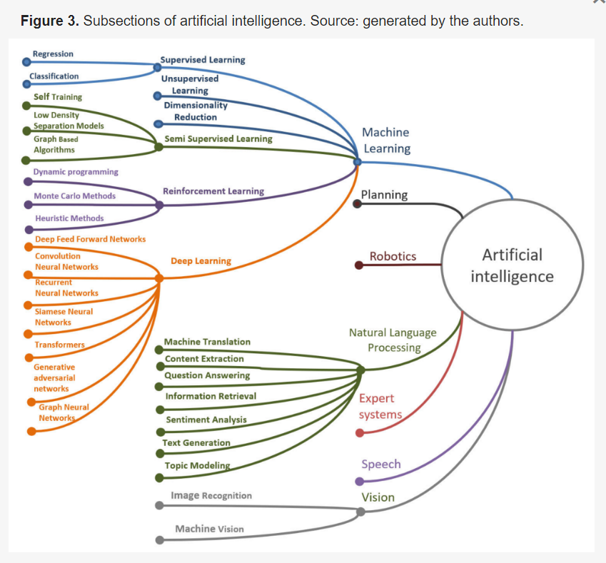
Transformer

Slide 3
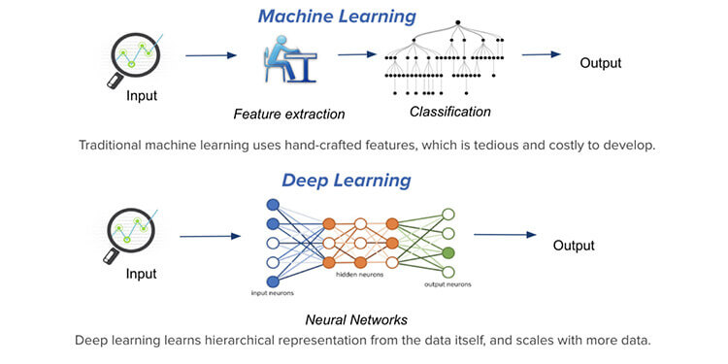

Slide 4
chat GPT
Generative Pre-trained Transformer
In a nutshell, Chat GPT is an
artificial intelligence (AI) content generator
that semi-autonomously creates phrases and articles
based on user input.

Slide 5
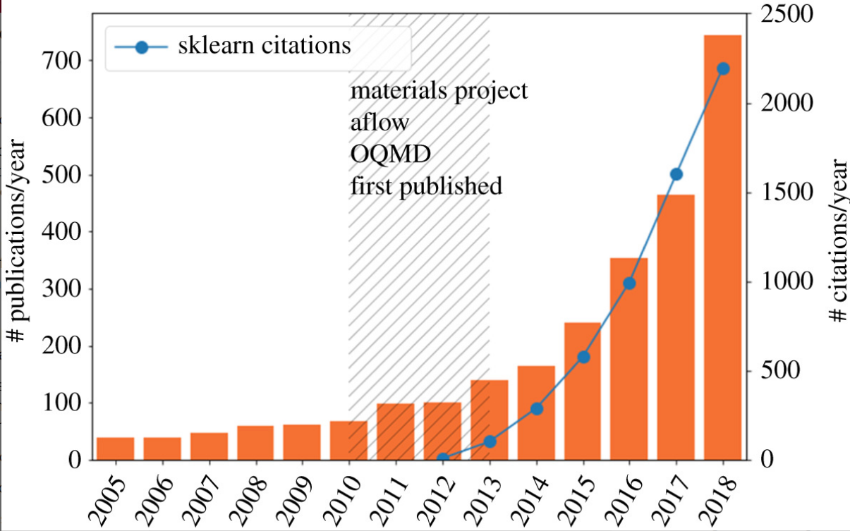
The ML explosion in materials science. The number of papers containing the terms machine learning
Machine learning and big scientific data Tony Hey , Keith Butler , Sam Jackson and Jeyarajan Thiyagalingam Published:20 January 2020

Slide 6
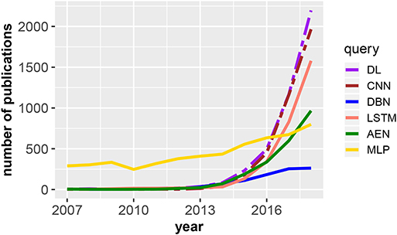
Number of publications in dependence on the publication year for DL, deep learning;
Frontiers | An Introductory Review of Deep Learning for Prediction Models With Big Data (frontiersin.org)

Slide 7
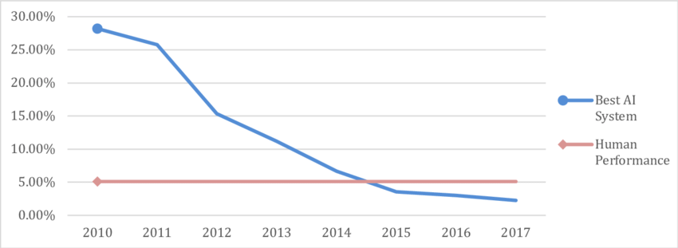
Error rate in the ImageNet Large Scale Visual Recognition Challenge. Data for AI performance from Shoham et al. (2018, p. 90), for human performance from Russakovsky et al. (2015, pp. 241&242).

Slide 8
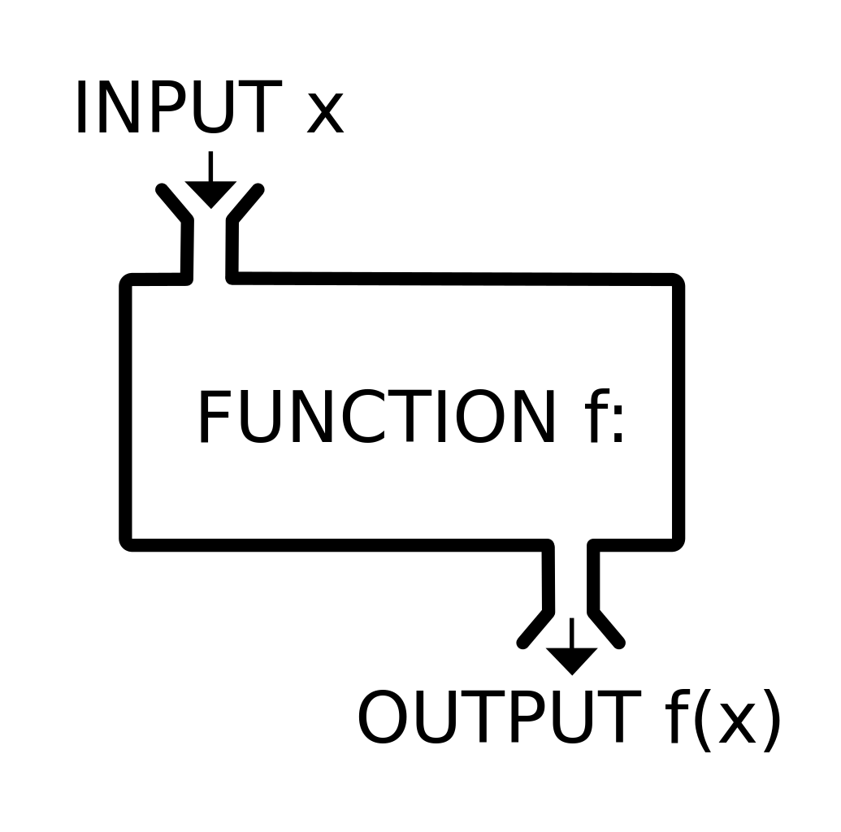
Function

Slide 9
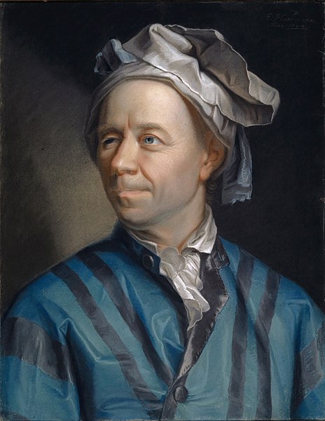
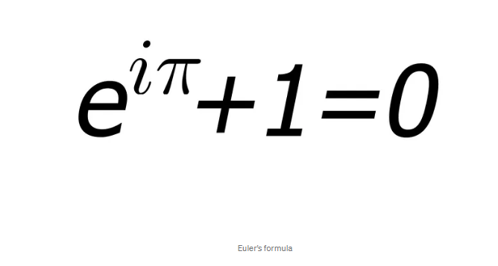
Leonhard Euler Introductio in Analysin Infinitorum. 1748

Slide 10
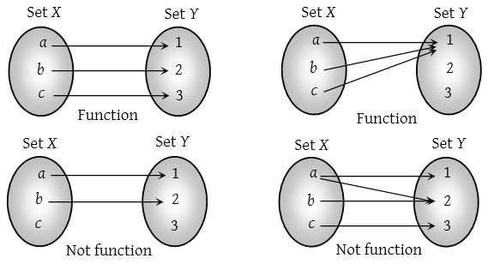
function

Slide 11
Function

Slide 12


Slide 13
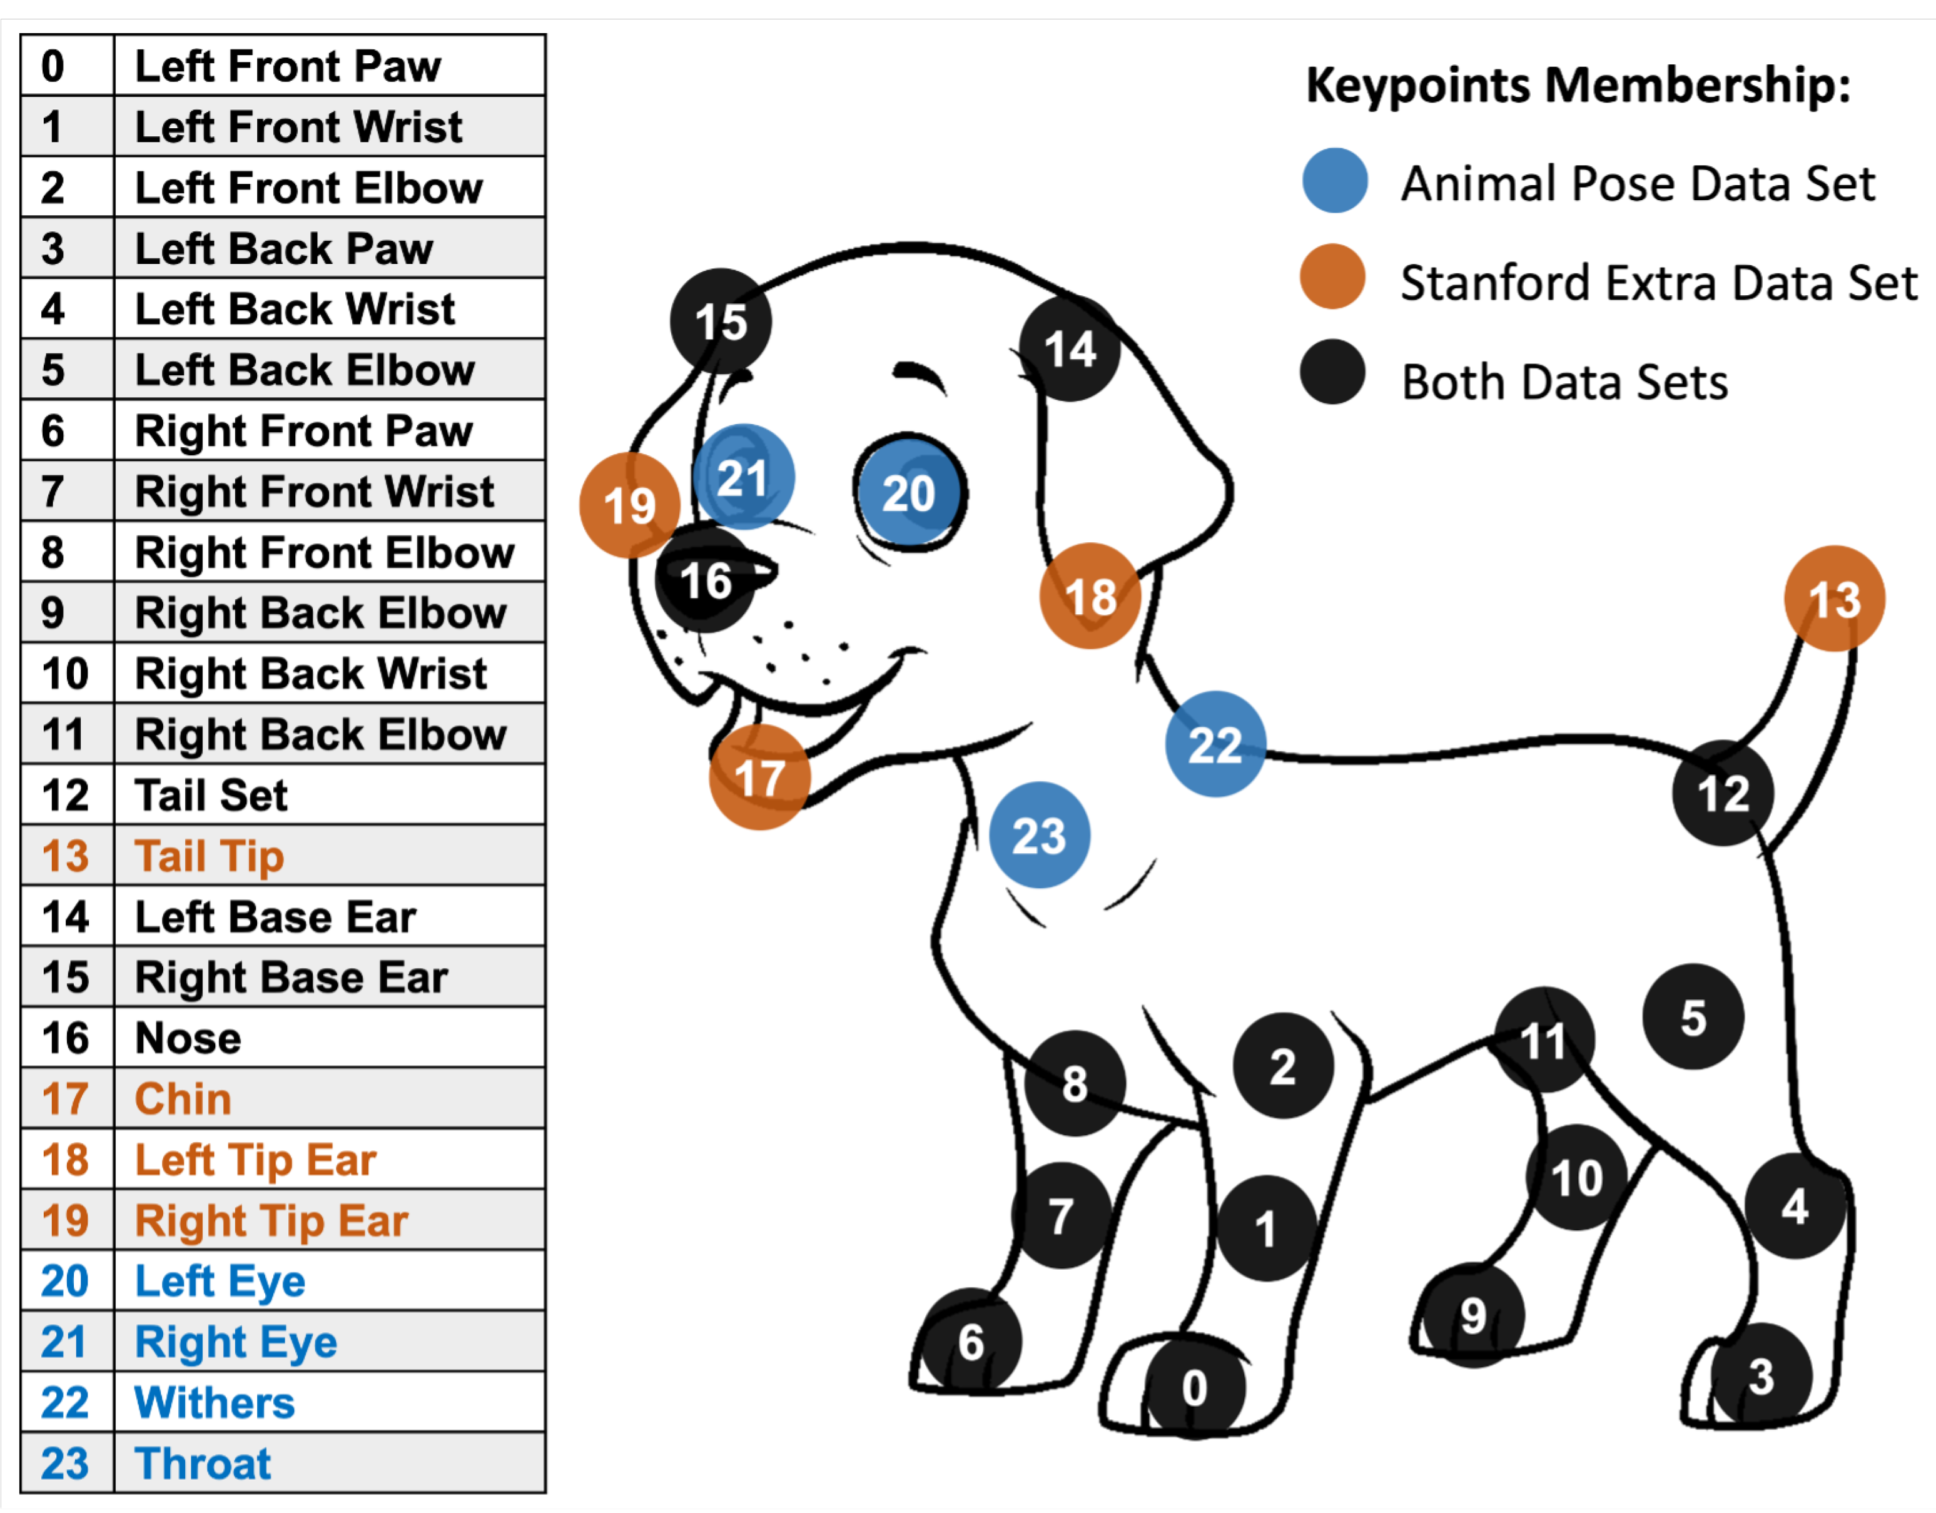

Slide 14
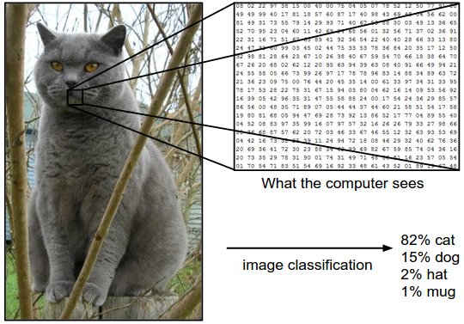

Slide 16
Function

